Slide 1
Game Playing

Slide 2
Outline
What are games?
Optimal decisions in games
Which strategy leads to success?
α-β pruning
Games of imperfect information
Games that include an element of chance

Slide 3
What are and why study games?
Games are a form of multi-agent environment
What do other agents do and how do they affect our success?
Cooperative vs. competitive multi-agent environments.
Competitive multi-agent environments give rise to adversarial (đối kháng) problems a.k.a. games
Game playing is a good problem for AI research
Game playing is non-trivial (không tầm thường)
Players need "human-like" intelligence
Games can be very complex (e.g. chess, go)
Requires decision making within limited time
Games usually are:
Well-defined and repeatable
Limited and accessible

Slide 4
Types of Games
 | Deterministic | Chance
Perfect Info (fully observable)
Inperfect Info (partially observable)
Chess, Checkers (cờ đam), Go (cờ vây), Othello
Backgammom, Monopoly
Brigde, Poker, Scrabble, Nuclear War

Slide 5
Relation of Games to Search
Search – no adversary
Games – adversary
Solution is (heuristic) method for finding goal
Heuristics and CSP (Constraint Satisfaction Problems) techniques can find optimal solution
Evaluation function: estimate of cost from start to goal through given node
Examples: path planning, scheduling activities
Solution is strategy (specifies move for every possible opponent reply).
Time limits force an approximate solution
Evaluation function: evaluate "goodness" of game position
Examples: chess, checkers, Othello, backgammon

Slide 6
Game setup
Two players: MAX and MIN
MAX moves first and they take turns until the game is over. Winner gets award, looser gets penalty.
Games as search:
States: board configuration of chess
Successor function: legal moves.
Goal test: Is the game finished? (winning/terminal board configuration).
initial state: start board configuration
MAX uses search tree to determine next move.

Slide 7
Game Playing as Search: Game Tree
What's the new aspect to the search problem?
There’s an opponent that we cannot control!
…
X
X
X
X
X
…
X
O
X
O
X
X
X
O
O
O
…
X
X
X
X
X
O
O
X
X
O
O
X
How can this be handled?

Slide 8
Game Playing as Search: Complexity
Assume the opponent’s moves can be predicted given the computer's moves.
How complex would search be in this case?
Worst case: O(b^{d}), branching factor, depth
Tic-Tac-Toe: ~5 legal moves, max of 9 moves
5⁹ = 1,953,125 states
Chess: ~35 legal moves, ~100 moves per game
35¹⁰⁰ ~10¹⁵⁴ states (but “only” ~10⁴⁰ legal states)
Common games produce enormous search trees!!

Slide 9
Greedy Search Game Playing
A utility function maps each terminal state of the board to a numeric value corresponding to the value of that state to the computer.
positive for winning, > + means better for computer (MAX)
negative for losing, > - means better for opponent (MIN)
zero for a draw
typical values (lost to win):
-infinity to +infinity
-1.0 to +1.0

Slide 10
Greedy Search Game Playing
Expand each branch to the terminal states
Evaluate the utility of each terminal state
Choose the move that results in the board configuration with the maximum value
A
A
9
computer's possible moves (MAX)
B
B
-5
C
C
9
D
D
2
E
E
3
opponent's possible moves (MIN)
F
-7
G
-5
H
3
I
9
J
-6
K
0
L
2
M
1
N
3
O
2
F
G
H
I
J
K
L
M
N
O
board evaluation from computer's perspective
terminal states

Slide 11
Greedy Search Game Playing
Assuming a reasonable search space, what's the problem with greedy search?
It ignores what the opponent might do!
e.g. MAX (computer) chooses C. MIN (opponent) chooses J and defeats computer.
A
9
computer's possible moves
B
-5
C
9
D
2
E
3
opponent's possible moves
F
-7
G
-5
H
3
I
9
J
-6
K
0
L
2
M
1
N
3
O
2
board evaluation from computer's perspective
terminal states

Slide 12
Minimax principle - Optimal strategies
Chooses the best move considering both its move and the opponent’s best move
Assumption: Both players play optimally !!
MAX (computer) maximizing the utility under the assumption after it moves MIN (opponent) will choose the minimizing move.
Given a game tree, the optimal strategy can be determined by using the minimax value of each node:
MINIMAX-VALUE(n) =
UTILITY(n) If n is a terminal max_{s ∈ successors(n)} MINIMAX-VALUE(s), If n is a max node min_{s ∈ successors(n)} MINIMAX-VALUE(s), If n is a min node

Slide 13
Two-Players Game Tree
The minimax decision
MAX
3
A₁
A₂
A₃
MIN
3
2
2
A₁₁
A₁₂
A₁₃
A₂₁
A₂₂
A₂₃
A₃₁
A₃₂
A₃₃
3
12
8
2
4
6
14
5
2
Minimax maximizes the worst-case outcome for max.

Slide 14
What if MIN does not play optimally?
Definition of optimal play for MAX assumes MIN plays optimally: maximizes worst-case outcome for MAX.
But if MIN does not play optimally, MAX will do even better. [Can be proved.]

Slide 15
Minimax: Direct Algorithm
For each move by the MAX (computer):
Perform depth-first search to a terminal state
Evaluate each terminal state
Propagate upwards the minimax values
if opponent's move minimum value of children backed up
if computer's move maximum value of children backed up
choose move with the maximum of minimax values of children
Note:
minimax values gradually propagate upwards as DFS proceeds: i.e., minimax values propagate up in “left-to-right” fashion
minimax values for sub-tree backed up “as we go”, so only O(bd) nodes need to be kept in memory at any time

Slide 16
Minimax Algorithm
function MINIMAX-DECISION(state) returns an action
inputs: state, current state in game
v ← MAX-VALUE(state)
return the action in SUCCESSORS(state) with value v
function MAX-VALUE(state) returns a utility value
if TERMINAL-TEST(state) then return UTILITY(state)
v ← -∞
for each s in SUCCESSORS(state) do
v ← MAX(v, MIN-VALUE(s))
return v
function MIN-VALUE(state) returns a utility value
if TERMINAL-TEST(state) then return UTILITY(state)
v ← +∞
for each s in SUCCESSORS(state) do
v ← MIN(v, MAX-VALUE(s))
return v

Slide 17
Properties of Minimax
Criterion | Minimax
Complete? | Yes (against an optimal opponent)
Time complexity | given branching factor b, O(b^{m})
Space complexity | O(bm) (depth-first exploration)
Optimal? | Yes (if tree is finite)
Time complexity is a major problem! Player typically only has a finite amount of time to make a move!!
For chess, b ≈ 35, m ≈100 for "reasonable" games → exact solution completely infeasible

Slide 18
Imperfect Real-Time Decisions
Minimax require too much leaf-node evaluations.
May be impractical within a reasonable amount of time.
SHANNON (1950):
Cut off search earlier (replace TERMINAL-TEST by CUTOFF-TEST)
Apply heuristic evaluation function EVAL (replacing utility function of alpha-beta)

Slide 19
Cutting off search
Change:
if TERMINAL-TEST(state) then return UTILITY(state)
into
if CUTOFF-TEST(state, depth) then return EVAL(state)
Introduces a fixed-depth limit depth
Is selected so that the amount of time will not exceed what the rules of the game allow.
When cuttoff occurs, the evaluation is performed.

Slide 20
Heuristic EVAL
EVAL function retuns an estimate of the expected utility of the game from a given position.
Performance of game playing depends on quality of EVAL.
Requirements:
EVAL must agree with terminal-nodes in the same way as UTILITY.
Computation may not take too long.
For non-terminal states the EVAL should be strongly correlated with the actual chance of winning.
Only useful for quiescent (no wild swings in value in near future) states

Slide 21
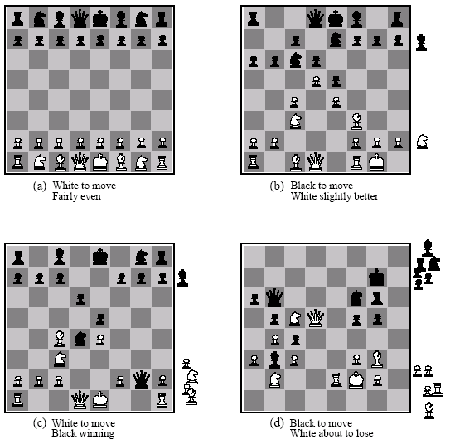
Heuristic EVAL example
Eval(s) = w₁ f₁(s) + w₂ f₂(s) + … + w_{n}f_{n}(s)

Slide 22
Heuristic EVAL example
Addition assumes
independence
Eval(s) = w₁ f₁(s) + w₂ f₂(s) + … + w_{n}f_{n}(s)

Slide 23
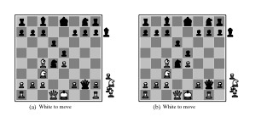
Heuristic difficulties
Heuristic counts pieces won

Slide 24
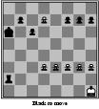
Horizon effect
Fixed depth search
thinks it can avoid
the queening move

Slide 25
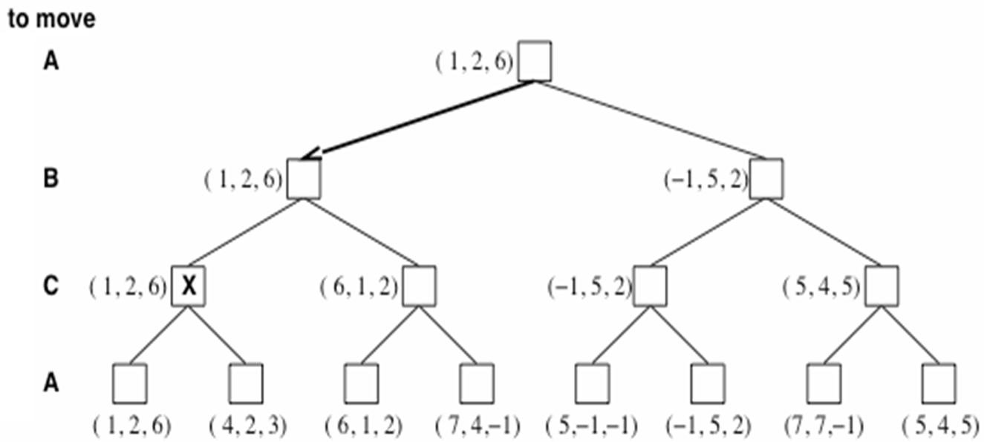
Multiplayer games
Games allow more than two players
Single minimax values become vectors

Slide 26
Problem of minimax search
Number of games states is exponential to the number of moves.
Some of the branches of the game tree won’t be taken if playing against an intelligent opponent
Solution: can "prune" those branches from the tree ==> Alpha-beta pruning
While doing DFS of game tree, keep track of:
Alpha = Highest value found so far at any choice point along the MAX path
Lower bound (cận dưới) on node’s utility
Beta = Lowest value found so far at any choice point along the MIN path
Higher bound (cận trên) on node’s utility

Slide 27
Alpha-Beta pruning
Beta cutoff pruning occurs when maximizing (MAX’s turn):
If alpha ≥ parent’s beta, stop expanding
Why stop expanding children?
Opponent shouldn’t allow the MAX to make this move
Alpha cutoff pruning occurs when minimizing (MIN’s turn):
If beta ≤ parent’s alpha, stop expanding
Why stop expanding children?
MAX shouldn’t take this route

Slide 28
Alpha-Beta Search Example
minimax(A,0,4)
alpha initialized to -infinity
Expand A? Yes since there are successors, no cutoff test for root
A
α=-∞
Call Stack
A
max
A
B
C
D
0
E
F
G
-5
H
3
I
8
J
K
L
2
M
N
4
O
P
9
Q
-6
R
0
S
3
T
5
U
-7
V
-9
W
-3
X
-5
A

Slide 29
Alpha-Beta Search Example
minimax(B,1,4)
beta initialized to +infinity
Expand B? Yes since A’s alpha >= B’s beta is false, no alpha cutoff
A
α=-∞
Call Stack
max
B
B
B β=+∞
C
D
0
E
min
F
G
-5
H
3
I
8
J
K
L
2
M
N
4
O
P
9
Q
-6
R
0
S
3
T
5
U
-7
V
-9
B
W
-3
X
-5
A

Slide 30
Alpha-Beta Search Example
minimax(F,2,4)
alpha initialized to -infinity
Expand F? Yes since F’s alpha >= B’s beta is false, no beta cutoff
A
α=-∞
Call Stack
max
B β=+∞
C
D
0
E
min
F
F
F α=-∞
G
-5
H
3
I
8
J
K
L
2
M
max
N
4
O
P
9
Q
-6
R
0
S
3
T
5
U
-7
V
-9
F
B
W
-3
X
-5
A

Slide 31
Alpha-Beta Search Example
minimax(N,3,4)
evaluate and return SBE value
A
α=-∞
Call Stack
max
B β=+∞
C
D
0
E
min
F α=-∞
G
-5
H
3
I
8
J
K
L
2
M
max
N
N
4
N
4
O
P
9
Q
-6
R
0
S
3
T
5
U
-7
V
-9
F
B
W
-3
X
-5
green: terminal state
A

Slide 32
Alpha-Beta Search Example
back to
minimax(F,2,4)
alpha = 4, since 4 >= -infinity (maximizing)
Keep expanding F? Yes since F’s alpha >= B’s beta is false, no beta cutoff
A
α=-∞
Call Stack
max
B β=+∞
C
D
0
E
min
F α=-
F α=4
G
-5
H
3
I
8
J
K
L
2
M
max
N
4
O
P
9
Q
-6
R
0
S
3
T
5
U
-7
V
-9
F
B
W
-3
X
-5
A
Notes:
4 maximum seen so far

Slide 33
Alpha-Beta Search Example
minimax(O,3,4)
beta initialized to +infinity
Expand O? Yes since F’s alpha >= O’s beta is false, no alpha cutoff
A
α=-∞
Call Stack
max
B β=+∞
C
D
0
E
min
F α=4
G
-5
H
3
I
8
J
K
L
2
M
max
O
N
4
O
O
O β=+∞
P
9
Q
-6
R
0
S
3
T
5
U
-7
V
-9
F
B
min
W
-3
X
-5
A

Slide 34
Alpha-Beta Search Example
minimax(W,4,4)
evaluate and return SBE value
A
α=-∞
Call Stack
max
B β=+∞
C
D
0
E
min
F α=4
G
-5
H
3
I
8
J
K
L
2
M
W
max
O
N
4
O β=+∞
P
9
Q
-6
R
0
S
3
T
5
U
-7
V
-9
F
B
min
W
-3
A
W
-3
X
-5
blue: non-terminal state (depth limit)

Slide 35
Alpha-Beta Search Example
back to
minimax(O,3,4)
beta = -3, since -3 <= +infinity (minimizing)
Keep expanding O?
No since F’s alpha >= O’s beta is true: alpha cutoff
A
α=-∞
Call Stack
max
B β=+∞
C
D
0
E
min
F α=4
G
-5
H
3
I
8
J
K
L
2
M
max
O
N
4
O β=+
O β=-3
P
9
Q
-6
R
0
S
3
T
5
U
-7
V
-9
F
B
min
W
-3
X
-5
A
Notes:
-3 minimum seen so far

Slide 36
Alpha-Beta Search Example
Why?
Smart opponent will choose W or worse, thus O's upper bound is –3. Computer already has better move at N.
A
α=-∞
Call Stack
max
B β=+∞
C
D
0
E
min
F α=4
G
-5
H
3
I
8
J
K
L
2
M
max
O
N
4
O β=-3
P
9
Q
-6
R
0
S
3
T
5
U
-7
V
-9
F
B
min
W
-3
X
-5
A
X
-5
red: pruned state

Slide 37
Alpha-Beta Search Example
back to
minimax(F,2,4)
alpha doesn’t change, since -3 < 4 (maximizing)
Keep expanding F? No since no more successors for F
A
α=-∞
Call Stack
max
B β=+∞
C
D
0
E
min
F α=4
G
-5
H
3
I
8
J
K
L
2
M
max
N
4
O β=-3
P
9
Q
-6
R
0
S
3
T
5
U
-7
V
-9
F
B
min
W
-3
X
-5
A
X
-5

Slide 38
Alpha-Beta Search Example
back to
minimax(B,1,4)
beta = 4, since 4 <= +infinity (minimizing)
Keep expanding B?
Yes since A’s alpha >= B’s beta is false, no alpha cutoff
A
α=-∞
Call Stack
max
B β=+
B β=4
C
D
0
E
min
F α=4
G
-5
H
3
I
8
J
K
L
2
M
max
N
4
O β=-3
P
9
Q
-6
R
0
S
3
T
5
U
-7
V
-9
B
min
W
-3
X
-5
A
X
-5

Slide 39
Alpha-Beta Search Example
minimax(G,2,4)
evaluate and return SBE value
A
α=-∞
Call Stack
max
B β=4
C
D
0
E
min
F α=4
G
-5
G
-5
H
3
I
8
J
K
L
2
M
max
N
4
O β=-3
P
9
Q
-6
R
0
S
3
T
5
U
-7
V
-9
G
B
min
W
-3
X
-5
A
X
-5
green: terminal state

Slide 40
Alpha-Beta Search Example
back to
minimax(B,1,4)
beta = -5, since -5 <= 4 (minimizing)
Keep expanding B? No since no more successors for B
A
α=-∞
Call Stack
max
B β=4
B β=-5
C
D
0
E
min
F α=4
G
-5
H
3
I
8
J
K
L
2
M
max
N
4
O β=-3
P
9
Q
-6
R
0
S
3
T
5
U
-7
V
-9
B
min
W
-3
X
-5
A
X
-5
Notes:
-5 minimum seen so far

Slide 41
Alpha-Beta Search Example
back to
minimax(A,0,4)
alpha = -5, since -5 >= -infinity (maximizing)
Keep expanding A? Yes since there are more successors, no cutoff test
A
α=
Call Stack
max
A
α=-5
B β=-5
C
D
0
E
min
F α=4
G
-5
H
3
I
8
J
K
L
2
M
max
N
4
O β=-3
P
9
Q
-6
R
0
S
3
T
5
U
-7
V
-9
min
W
-3
X
-5
A
X
-5
Notes:
-5 maximum seen so far

Slide 42
Alpha-Beta Search Example
minimax(C,1,4)
beta initialized to +infinity
Expand C? Yes since A’s alpha >= C’s beta is false, no alpha cutoff
A
α=
Call Stack
max
A
α=-5
B β=-5
C
C
C
β=+∞
D
0
E
min
F α=4
G
-5
H
3
I
8
J
K
L
2
M
max
N
4
O β=-3
P
9
Q
-6
R
0
S
3
T
5
U
-7
V
-9
C
min
W
-3
X
-5
A
X
-5

Slide 43
Alpha-Beta Search Example
minimax(H,2,4)
evaluate and return SBE value
A
α=
Call Stack
max
A
α=-5
B β=-5
C
β=+∞
D
0
E
min
F α=4
G
-5
H
3
H
3
I
8
J
K
L
2
M
max
N
4
O β=-3
P
9
Q
-6
R
0
S
3
T
5
U
-7
V
-9
H
C
min
W
-3
X
-5
A
X
-5
green: terminal state

Slide 44
Alpha-Beta Search Example
back to
minimax(C,1,4)
beta = 3, since 3 <= +infinity (minimizing)
Keep expanding C? Yes since A’s alpha >= C’s beta is false, no alpha cutoff
A
α=
Call Stack
max
A
α=-5
B β=-5
C
β=+
C
β=3
D
0
E
min
F α=4
G
-5
H
3
I
8
J
K
L
2
M
max
N
4
O β=-3
P
9
Q
-6
R
0
S
3
T
5
U
-7
V
-9
C
min
W
-3
X
-5
A
X
-5

Slide 45
Alpha-Beta Search Example
minimax(I,2,4)
evaluate and return SBE value
A
α=
Call Stack
max
A
α=-5
B β=-5
C
β=3
D
0
E
min
F α=4
G
-5
H
3
I
8
I
8
J
K
L
2
M
max
N
4
O β=-3
P
9
Q
-6
R
0
S
3
T
5
U
-7
V
-9
I
C
min
W
-3
X
-5
A
X
-5
green: terminal state

Slide 46
Alpha-Beta Search Example
back to
minimax(C,1,4)
beta doesn’t change, since 8 > 3 (minimizing)
Keep expanding C? Yes since A’s alpha >= C’s beta is false, no alpha cutoff
A
α=
Call Stack
max
A
α=-5
B β=-5
C
β=3
D
0
E
min
F α=4
G
-5
H
3
I
8
J
K
L
2
M
max
N
4
O β=-3
P
9
Q
-6
R
0
S
3
T
5
U
-7
V
-9
C
min
W
-3
X
-5
A
X
-5

Slide 47
Alpha-Beta Search Example
minimax(J,2,4)
alpha initialized to -infinity
Expand J? Yes since J’s alpha >= C’s beta is false, no beta cutoff
A
α=
Call Stack
max
A
α=-5
B β=-5
C
β=3
D
0
E
min
F α=4
G
-5
H
3
I
8
J
J
J
α=-
K
L
2
M
max
N
4
O β=-3
P
9
Q
-6
R
0
S
3
T
5
U
-7
V
-9
J
C
min
W
-3
X
-5
A
X
-5

Slide 48
Alpha-Beta Search Example
minimax(P,3,4)
evaluate and return SBE value
A
α=
Call Stack
max
A
α=-5
B β=-5
C
β=3
D
0
E
min
F α=4
G
-5
H
3
I
8
J
α=-∞
K
L
2
M
max
P
N
4
O β=-3
P
9
P
9
Q
-6
R
0
S
3
T
5
U
-7
V
-9
J
C
min
W
-3
X
-5
A
X
-5
green: terminal state

Slide 49
Alpha-Beta Search Example
back to
minimax(J,2,4)
alpha = 9, since 9 >= -infinity (maximizing)
Keep expanding J?
No since J’s alpha >= C’s beta is true: beta cutoff
A
α=
Call Stack
max
A
α=-5
B β=-5
C
β=3
D
0
E
min
F α=4
G
-5
H
3
I
8
J
α=-
J
α=9
K
L
2
M
max
N
4
O β=-3
P
9
Q
-6
Q
-6
R
0
R
0
S
3
T
5
U
-7
V
-9
J
C
min
W
-3
X
-5
A
X
-5
red: pruned states

Slide 50
Alpha-Beta Search Example
Why?
Computer will choose P or better, thus J's lower bound is 9. Smart opponent won’t let computer take move to J (since opponent already has better move at H).
A
α=
Call Stack
max
A
α=-5
B β=-5
C
β=3
D
0
E
min
F α=4
G
-5
H
3
I
8
J
α=9
K
L
2
M
max
N
4
O β=-3
P
9
Q
-6
R
0
S
3
T
5
U
-7
V
-9
J
C
min
W
-3
X
-5
A
X
-5
red: pruned states

Slide 51
Alpha-Beta Search Example
back to
minimax(C,1,4)
beta doesn’t change, since 9 > 3 (minimizing)
Keep expanding C? No since no more successors for C
A
α=
Call Stack
max
A
α=-5
B β=-5
C
β=3
D
0
E
min
F α=4
G
-5
H
3
I
8
J
α=9
K
L
2
M
max
N
4
O β=-3
P
9
Q
-6
R
0
S
3
T
5
U
-7
V
-9
C
min
W
-3
X
-5
A
X
-5

Slide 52
Alpha-Beta Search Example
back to
minimax(A,0,4)
alpha = 3, since 3 >= -5 (maximizing)
Keep expanding A? Yes since there are more successors, no cutoff test
A
α=-5
Call Stack
max
A
α=3
B β=-5
C
β=3
D
0
E
min
F α=4
G
-5
H
3
I
8
J
α=9
K
L
2
M
max
N
4
O β=-3
P
9
Q
-6
R
0
S
3
T
5
U
-7
V
-9
min
W
-3
X
-5
A
X
-5

Slide 53
Alpha-Beta Search Example
minimax(D,1,4)
evaluate and return SBE value
A
α=
Call Stack
max
A
α=3
B β=-5
C
β=3
D
0
D
0
E
min
F α=4
G
-5
H
3
I
8
J
α=9
K
L
2
M
max
N
4
O β=-3
P
9
Q
-6
R
0
S
3
T
5
U
-7
V
-9
D
min
W
-3
X
-5
A
X
-5
green: terminal state

Slide 54
Alpha-Beta Search Example
back to
minimax(A,0,4)
alpha doesn’t change, since 0 < 3 (maximizing)
Keep expanding A? Yes since there are more successors, no cutoff test
A
α=
Call Stack
max
A
α=3
B β=-5
C
β=3
D
0
E
min
F α=4
G
-5
H
3
I
8
J
α=9
K
L
2
M
max
N
4
O β=-3
P
9
Q
-6
R
0
S
3
T
5
U
-7
V
-9
min
W
-3
X
-5
A
X
-5

Slide 55
Alpha-Beta Search Example
How does the algorithm finish searching the tree?
A
α=
Call Stack
max
A
α=3
B β=-5
C
β=3
D
0
E
min
F α=4
G
-5
H
3
I
8
J
α=9
K
L
2
M
max
N
4
O β=-3
P
9
Q
-6
R
0
S
3
T
5
U
-7
V
-9
min
W
-3
X
-5
A
X
-5

Slide 56
Alpha-Beta Search Example
Stop Expanding E since A's alpha >= E's beta is true: alpha cutoff
Why?
Smart opponent will choose L or worse, thus E's upper bound is 2.
Computer already has better move at C.
A
α=
Call Stack
max
A
α=3
B β=-5
C
β=3
D
0
E
β=2
min
F α=4
G
-5
H
3
I
8
J
α=9
K
α=5
L
2
M
max
N
4
O β=-3
P
9
Q
-6
R
0
S
3
T
5
U
-7
V
-9
min
W
-3
X
-5
A
X
-5

Slide 57
Alpha-Beta Search Example
Result: Computer chooses move to C.
A
α=
Call Stack
max
A
α=3
B β=-5
C
β=3
D
0
E
β=2
min
F α=4
G
-5
H
3
I
8
J
α=9
K
α=5
L
2
M
max
N
4
O β=-3
P
9
Q
-6
R
0
S
3
T
5
U
-7
V
-9
min
W
-3
X
-5
A
X
-5
green: terminal states, red: pruned states blue: non-terminal state (depth limit)

Slide 58
Alpha-Beta Algorithm
function ALPHA-BETA-SEARCH(state) returns an action
inputs: state, current state in game
v ← MAX-VALUE(state, - ∞ , +∞)
return the action in SUCCESSORS(state) with value v
function MAX-VALUE(state, α, β) returns a utility value
if TERMINAL-TEST(state) then return UTILITY(state)
v ← - ∞
for each s in SUCCESSORS(state) do
v ← MAX(v, MIN-VALUE(s, α, β))
if v ≥ β then return v
α ← MAX(α, v)
return v

Slide 59
Alpha-Beta Algorithm
function MIN-VALUE(state, α , β) returns a utility value
if TERMINAL-TEST(state) then return UTILITY(state)
v ← + ∞
for each s in SUCCESSORS(state) do
v ← MIN(v, MAX-VALUE(s, α , β))
if v ≤ α then return v
β ← MIN(β ,v)
return v

Slide 60
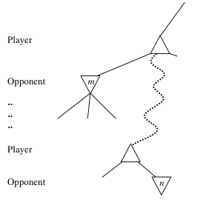
General alpha-beta pruning
Consider a node n somewhere in the tree
If player has a better choice at
Parent node of n
Or any choice point further up
n will never be reached in actual play.
Hence when enough is known about n, it can be pruned.

Slide 61
Final Comments: Alpha-Beta Pruning
Pruning does not affect final results
Entire subtrees can be pruned.
Good move ordering improves effectiveness of pruning
With "perfect ordering" time complexity is O(b^{m/2})
Branching factor of sqrt(b) !!
Alpha-beta pruning can look twice as far as minimax in the same amount of time
Repeated states are again possible.
Store them in memory = transposition table

Slide 62
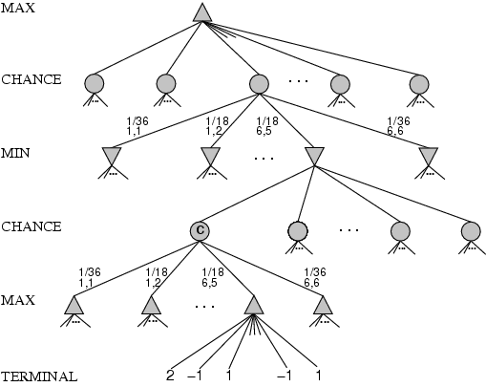
Games that include chance
Possible moves (5-10, 5-11), (5-11, 19-24), (5-10, 10-16) and (5-11, 11-16)

Slide 63
Games that include chance
chance nodes
Possible moves (5-10, 5-11), (5-11, 19-24), (5-10, 10-16) and (5-11, 11-16)
[1,1], [6,6] chance 1/36, all other chance 1/18

Slide 64
Games that include chance
[1,1], [6,6] chance 1/36, all other chance 1/18
Can not calculate definite minimax value, only expected value

Slide 65
Expected minimax value
EXPECTED-MINIMAX-VALUE(n) =
UTILITY(n) If n is a terminal
max_{s ∈ successors(n)} MINIMAX-VALUE(s) If n is a max node
min_{s ∈ successors(n)} MINIMAX-VALUE(s) If n is a max node
∑_{s ∈ successors(n)} P(s) . EXPECTEDMINIMAX(s) If n is a chance node
These equations can be backed-up recursively all the way to the root of the game tree.

Slide 66
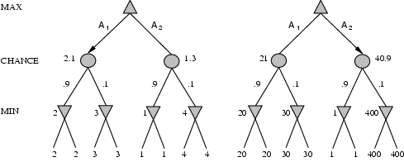
Position evaluation with chance nodes
Left, A1 wins
Right A2 wins
Outcome of evaluation function may not change when values are scaled differently.
Behavior is preserved only by a positive linear transformation of EVAL.

Slide 67
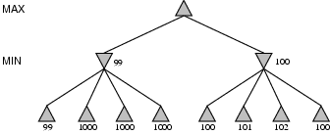
Discussion
Examine section on state-of-the-art games yourself
Minimax assumes right tree is better than left, yet
Return probability distribution over possible values
Yet expensive calculation

Slide 68
Discussion
Utility of node expansion
Only expand those nodes which lead to significanlty better moves
Both suggestions require meta-reasoning

Slide 69
Summary
Games are fun (and dangerous)
They illustrate several important points about AI
Perfection is unattainable -> approximation
Good idea what to think about
Uncertainty constrains the assignment of values to states
Games are to AI as grand prix racing is to automobile design.

